Slide 1
Digital Fundamentals
CHAPTER 4 Boolean Algebra and Logic Simplification

Slide 2
Chapter Outline
4–1 Boolean Operations and Expressions
4–2 Laws and Rules of Boolean Algebra
4–3 DeMorgan’s Theorems
4–4 Boolean Analysis of Logic Circuits
4–5 Logic Simplification Using Boolean Algebra
4–6 Standard Forms of Boolean Expressions
4–7 Boolean Expressions and Truth Tables
4–8 The Karnaugh Map
4–9 Karnaugh Map SOP Minimization
4–10 Karnaugh Map POS Minimization
4–11 The Quine-McCluskey Method
4–12 Boolean Expressions with VHDL Applied Logic

Slide 3
4-8 The Karnaugh Map

Slide 4
Definitions
Literals A or A
Product Term ABC
Sum Term A + B + C
Minterm of n variables: A product of n literals
in which every variable appears exactly once.
Maxterm of n variables: A sum of n literals
in which every variable appears exactly once.
4

Slide 5
Implementation
Specification ➔ Schematic Diagram
Net list,
Switching expression
Obj min cost ➔ Search in solution space
(max performance)
Cost: wires, gates ➔ Literals, product terms,
sum terms
We want to minimize # of terms, # of literals
5

Slide 6
Implementation
Flow:
Specification
Truth Table
Karnaugh Map (truth table in two dimensional space)
Sum of Products or Product of Sums
Schematic Diagram of Two Level Logic
6

Slide 7
Grouping Rules
Group “1”s with rectangles
Can use the same minterm more than once
Can wrap around the edges of the map
Some rules in selecting groups:
Try to use as few groups as possible to cover all “1”s.
For each group, try to make it as large as you can

Slide 8
Two-Variable K-map
A
B
B
A
0
0
m
0
1
0
0
1
m
1
0
m
0
m
1
1
0
m
2
1
m
2
m
3
1
1
m
3
(a) Truth table
(b) Karnaugh map
[ Figure 2.49 from the textbook ]

Slide 9
Step-By-Step Example
A
B
0
0
1
0
1
1
1
0
0
1
1
1

Slide 10
1. Draw The Map
A
B
B
A
m
0
0
0
1
0
1
m
1
0
1
1
0
m
m
0
1
m
2
1
0
0
m
1
m
2
m
3
1
1
1
3

Slide 11
2. Fill the Map
A
B
B
m
A
0
0
0
1
0
1
m
0
1
1
m
m
1
0
1
0
1
1
m
2
1
0
0
m
m
m
1
0
2
1
3
1
1
1
3

Slide 12
3. Group
A
B
B
A
m
0
0
0
1
0
1
m
1
0
1
1
0
1
1
m
2
1
0
0
m
1
0
1
3
1
1
1

Slide 13
4. Write The Expression
A
B
B
A
m
0
0
0
1
0
1
m
1
0
1
1
0
1
1
m
2
1
0
0
m
1
0
1
3
1
1
1
A + B

Slide 14
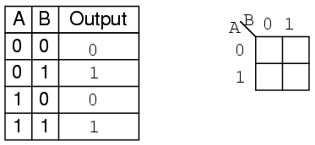
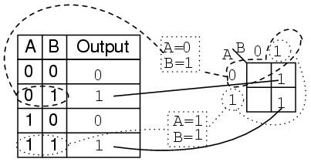
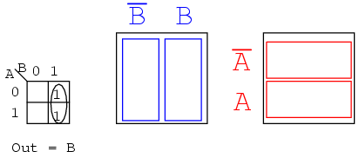
The Karnaugh Map

Slide 15
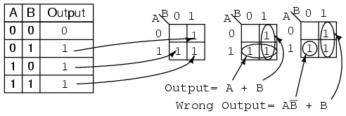
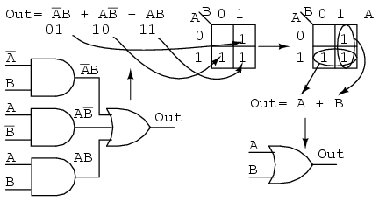
The Karnaugh Map

Slide 16
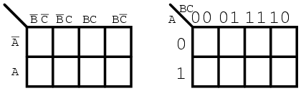
The Karnaugh Map
Note the sequence of numbers across the top of the map. It is not in binary sequence which would be 00, 01, 10, 11. It is 00, 01, 11 10, which is Gray code sequence.
Gray code sequence only changes one binary bit as we go from one number to the next in the sequence, unlike binary. That means that adjacent cells will only vary by one bit, or Boolean variable.
A B C
A BC
ABC
ABC
m
0
m
1
m
3
m
2
AB C
ABC
ABC
ABC
m
4
m
5
m
7
m
6

Slide 17
The Karnaugh Map
Note the sequence of numbers across the top of the map. It is not in binary sequence which would be 00, 01, 10, 11. It is 00, 01, 11 10, which is Gray code sequence.
Gray code sequence only changes one binary bit as we go from one number to the next in the sequence, unlike binary. That means that adjacent cells will only vary by one bit, or Boolean variable.
A B C
A BC
ABC
ABC
m
0
m
1
m
3
m
2
AB C
ABC
ABC
ABC
m
4
m
5
m
7
m
6

Slide 18
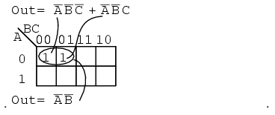
Examples of Simplification with Karnaugh Maps
000=m₀
001=m₁

Slide 19
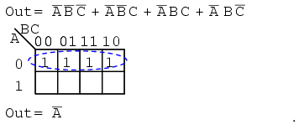
Examples of Simplification with Karnaugh Maps
000=m₀
001=m₁
011=m₃
010=m₂

Slide 20
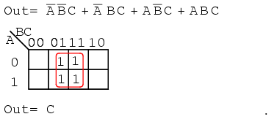
Examples of Simplification with Karnaugh Maps
001=m_{1`}
011=m₃
101=m₅
111=m₇

Slide 21
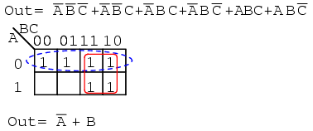
Examples of Simplification with Karnaugh Maps
000=m₀
001=m₁
011=m₃
010=m₂
111=m₇
110=m₆

Slide 22
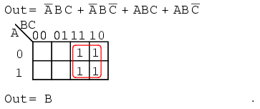
Examples of Simplification with Karnaugh Maps
011=m₃
010=m₂
111=m₇
110=m₆

Slide 23
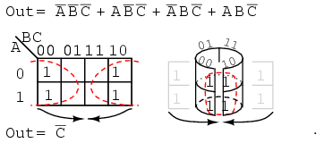
Examples of Simplification with Karnaugh Maps

Slide 24
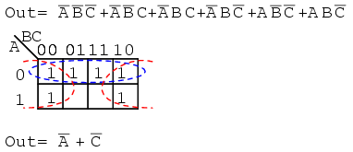
Examples of Simplification with Karnaugh Maps

Slide 25
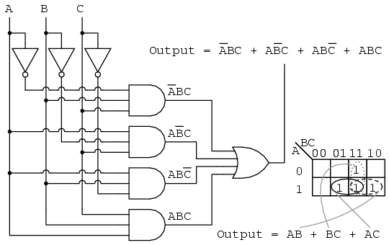
Examples of Simplification with Karnaugh Maps
ABC + ABC +ABC+ABC

Slide 26
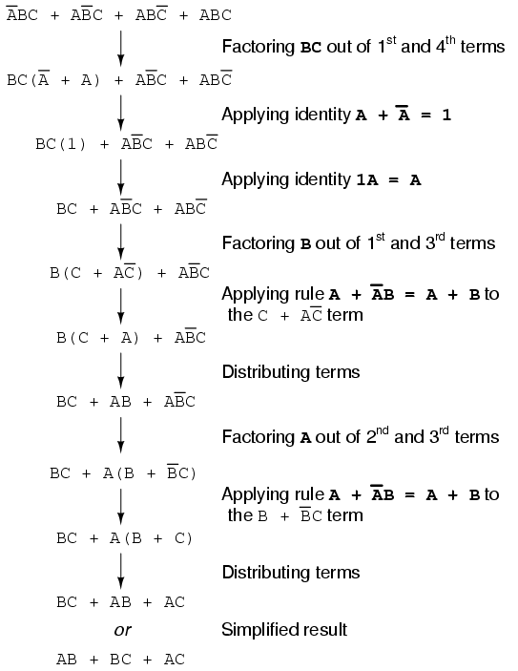
Examples of Simplification with Karnaugh Maps

Slide 27
Examples of Simplification with Karnaugh Maps

Slide 28
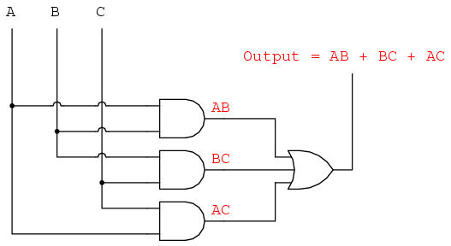
Examples of Simplification with Karnaugh Maps

Slide 29
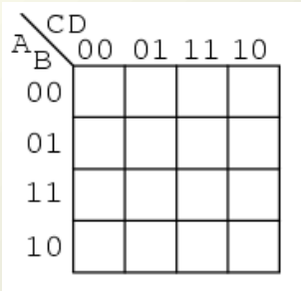
Larger 4-variable Karnaugh Maps
ABCD | m
0000 | m0
0001 | m1
0010 | m2
0011 | m3
0100 | m4
0101 | m5
0110 | m6
0111 | m7
1000 | m8
1001 | m9
1010 | m10
1011 | m11
1100 | m12
1101 | m13
1110 | m14
1111 | m15
m₀
m₁
m₃
m₂
m₄
m₅
m₇
m₆
m₁₂
m₁₃
m₁₅
m₁₄
m₈
m₉
m₁₁
m₁₀

Slide 30
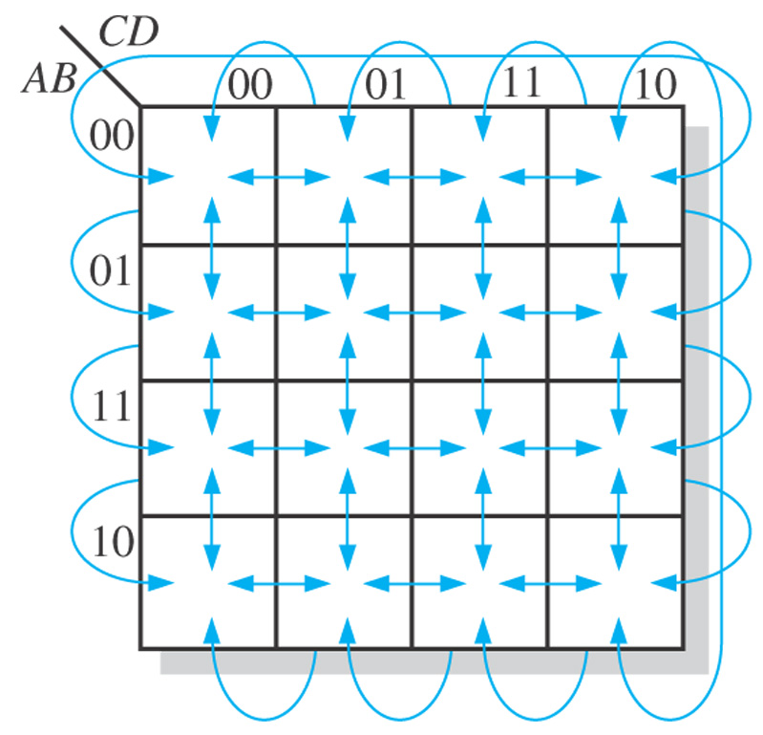
Figure 4–23 Adjacent cells on a Karnaugh map are those that differ by only one variable. Arrows point between adjacent cells.
Notes:
30

Slide 31
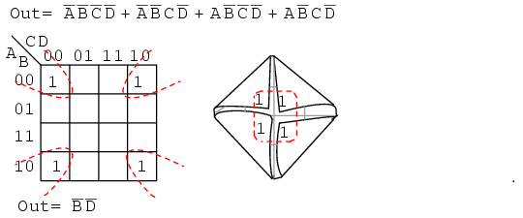
Larger 4-variable Karnaugh Maps
A B C D +A BCD +AB C D +ABCD
0000=m₀
0010=m₂
1000=m₈
1010=m₁₀

Slide 32
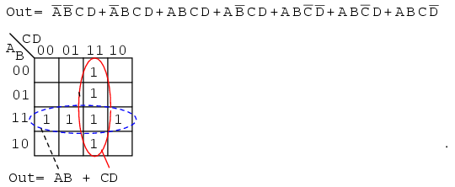
Larger 4-variable Karnaugh Maps
0011=m₃
0111=m₇
1111=m_{15`}
1011=m_{11`}
1100=m_{12`}
1101=m_{13`}
1110=m_{14`}

Slide 33
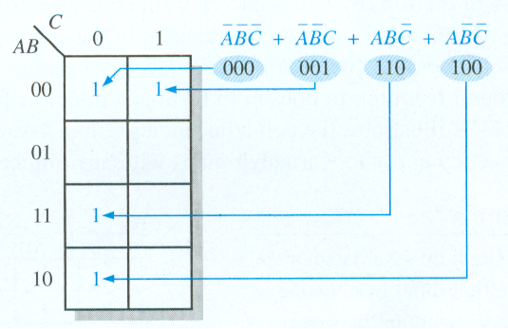
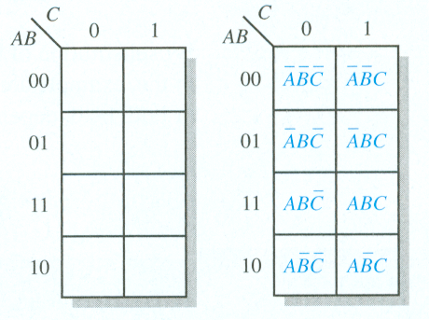
The Karnaugh Map
3-Variable Example
3-Variable Karnaugh Map

Slide 34
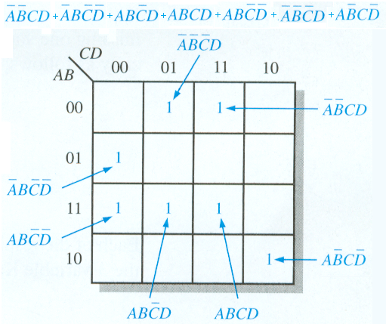
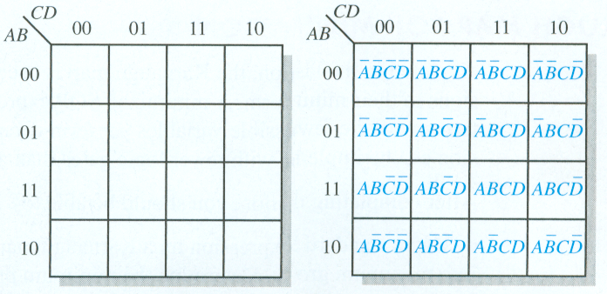
The Karnaugh Map
4-Variable Karnaugh Map
4-Variable Example

Slide 35
Figure 4–23 Adjacent cells on a Karnaugh map are those that differ by only one variable. Arrows point between adjacent cells.
Notes:
35

Slide 36
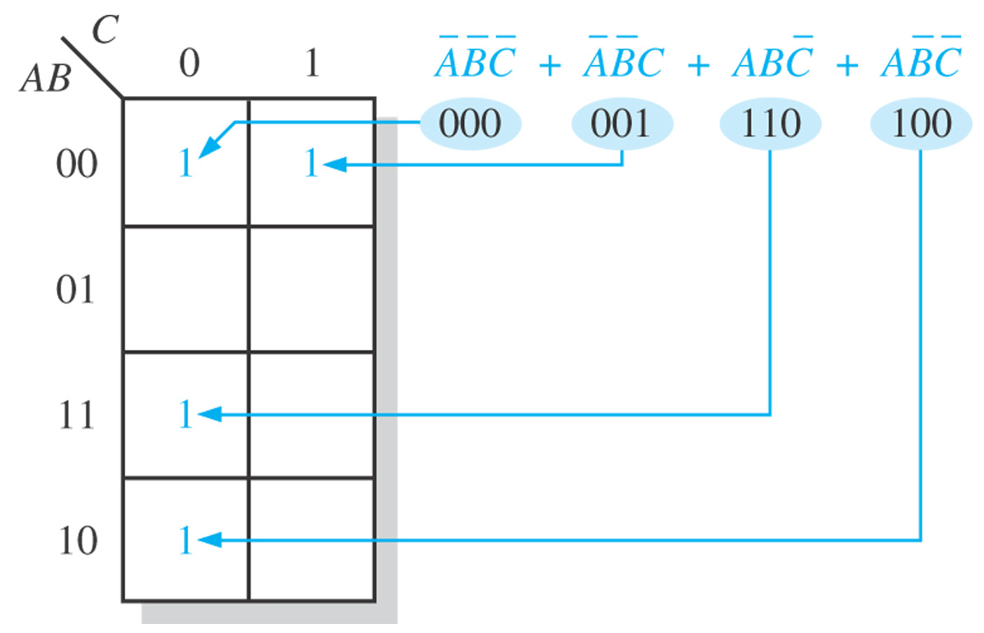
Figure 4–24 Example of mapping a standard SOP expression.
Notes:
36

Slide 37
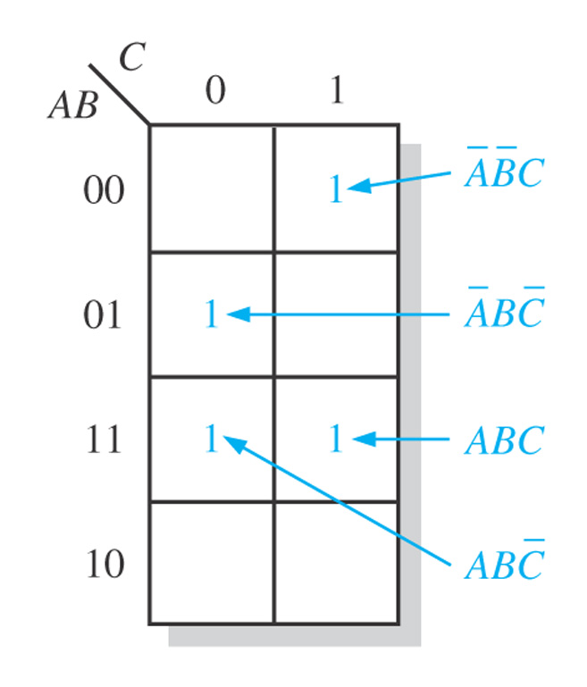
Figure 4–25
Notes:
37

Slide 38
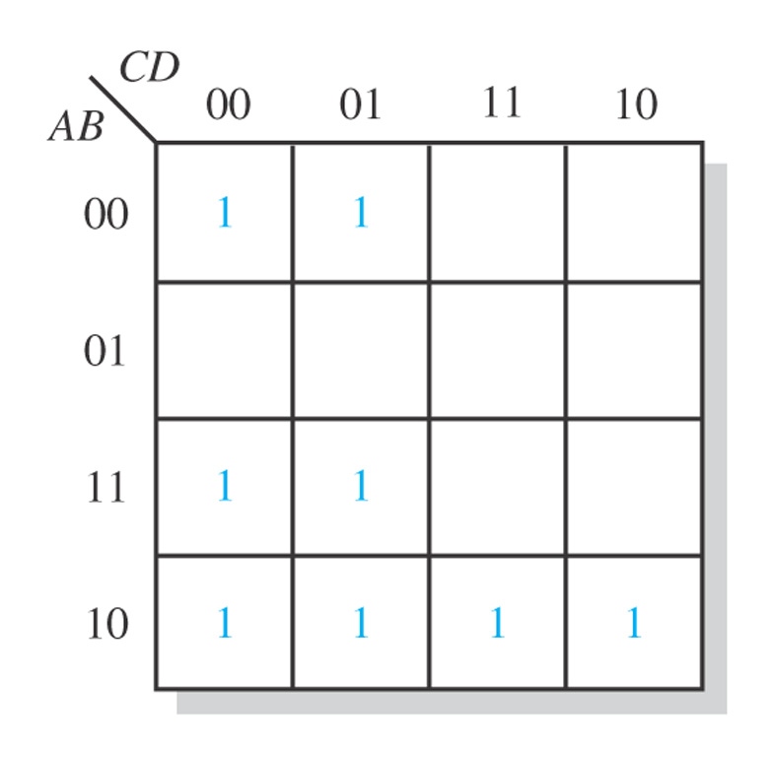
Figure 4–28
Notes:
38

Slide 39
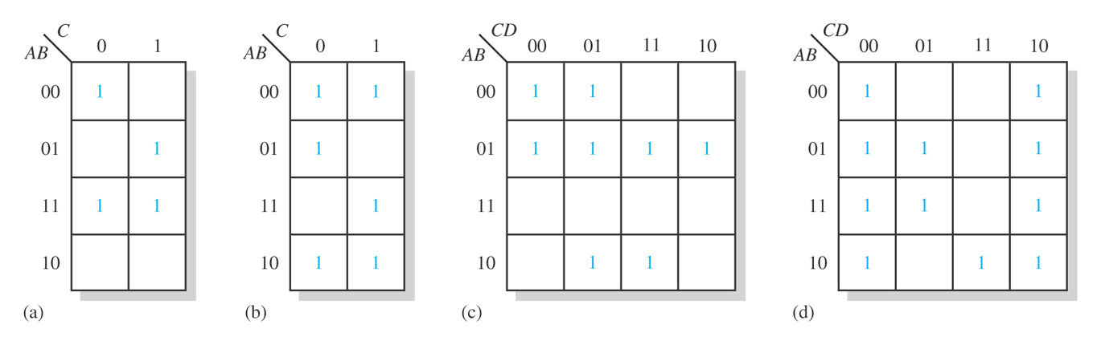
Figure 4–29
Notes:
39

Slide 40
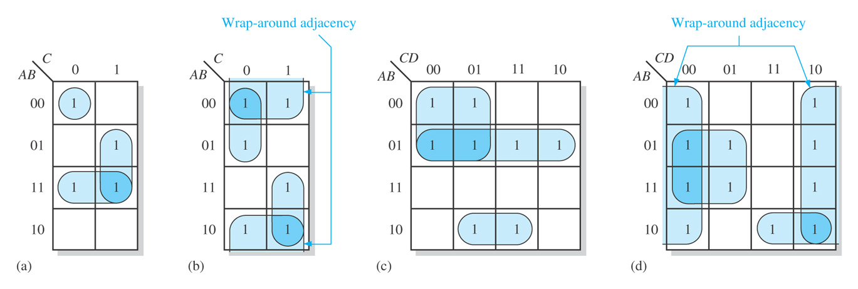
Figure 4–30
Notes:
40

Slide 41
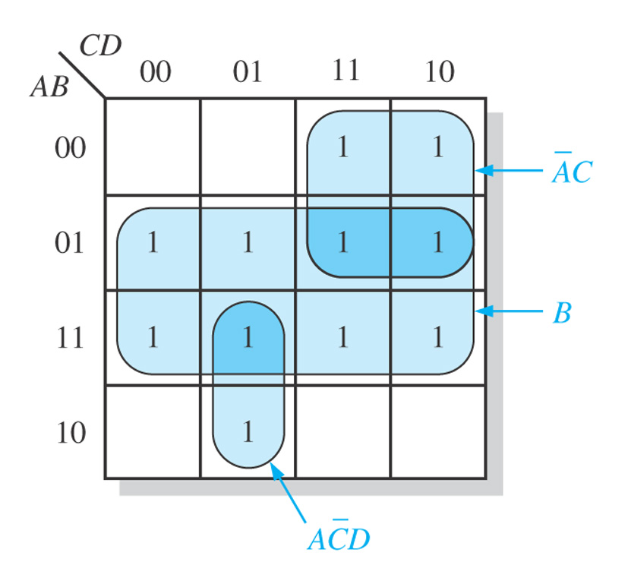
Figure 4–31
Notes:
41

Slide 42
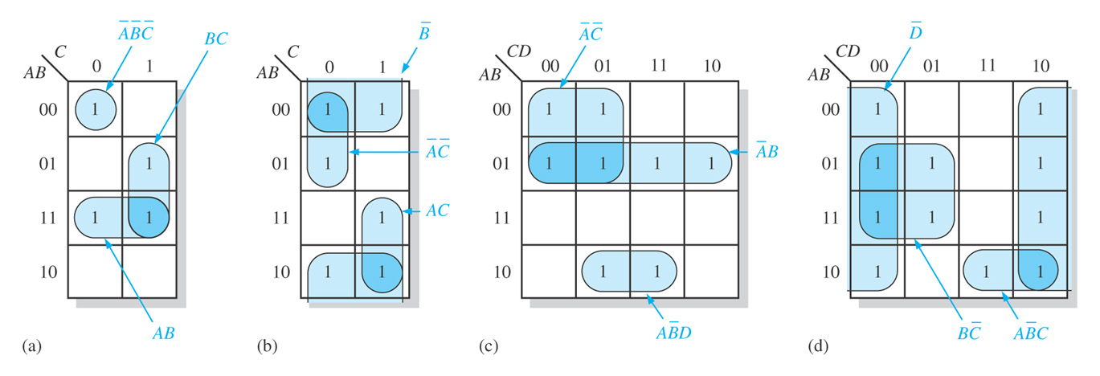
Figure 4–32
Notes:
42

Slide 43
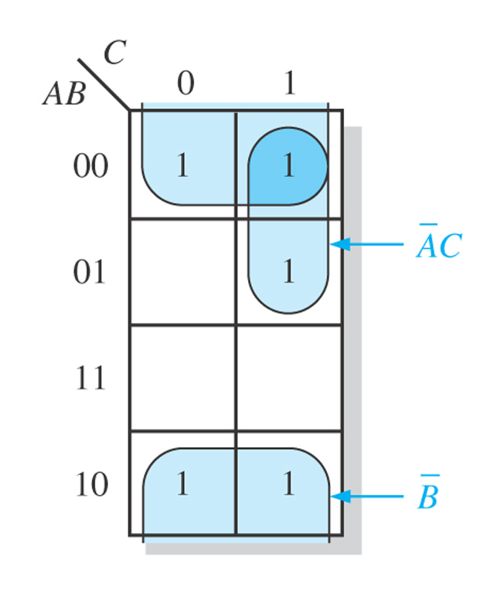
Figure 4–33
Notes:
43

Slide 44
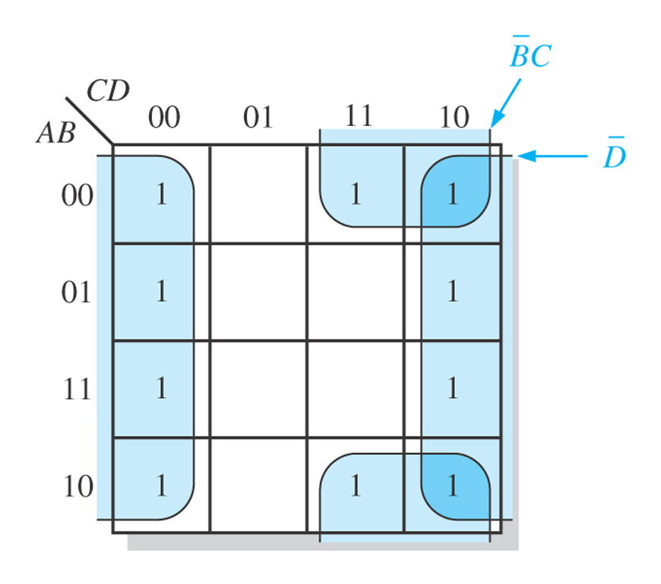
Figure 4–34
Notes:
44

Slide 45
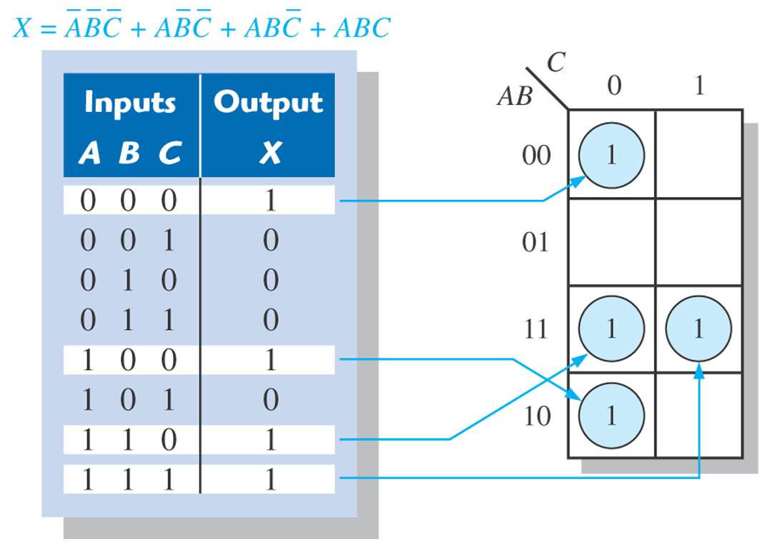
Figure 4–35 Example of mapping directly from a truth table to a Karnaugh map.
Notes:
45

Slide 46
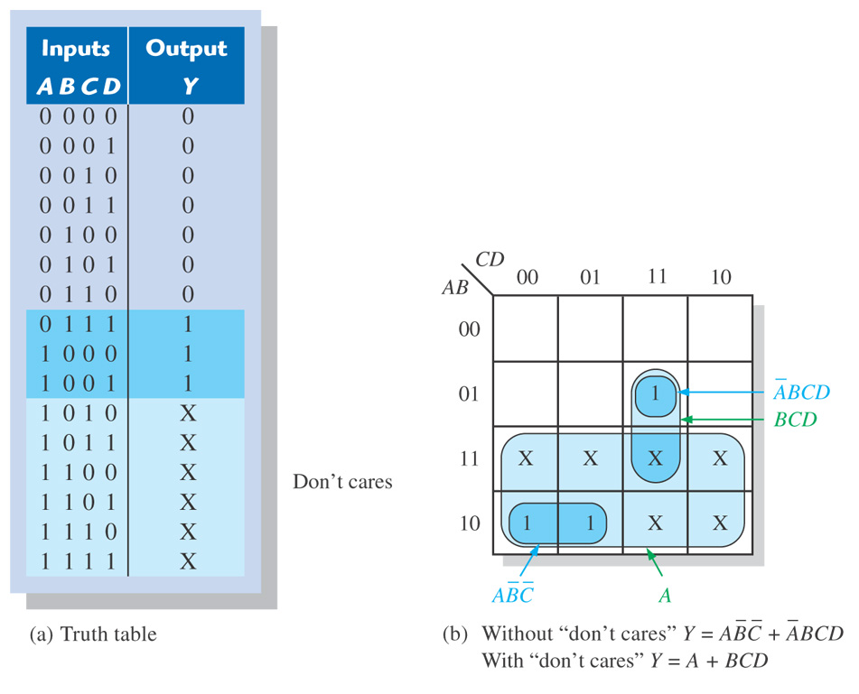
Figure 4–36 Example of the use of “don’t care” conditions to simplify an expression.
Notes:
46

Slide 47
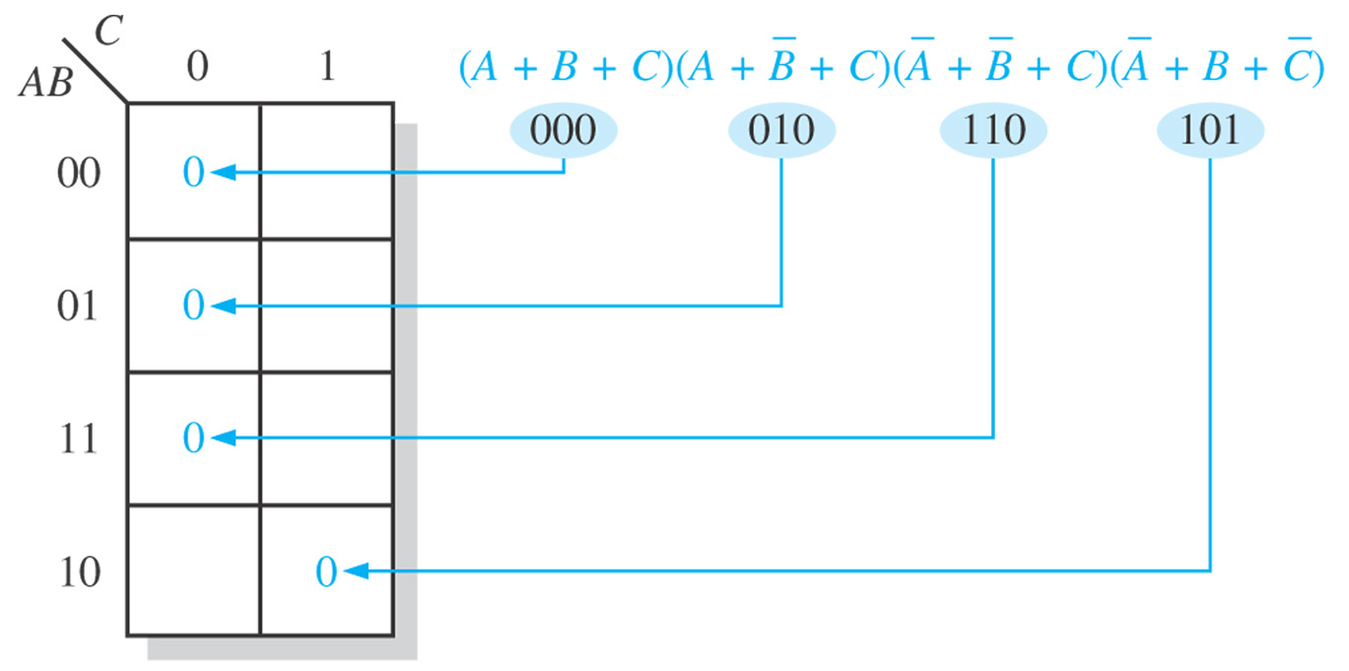
Figure 4–37 Example of mapping a standard POS expression.
Notes:
47

Slide 48
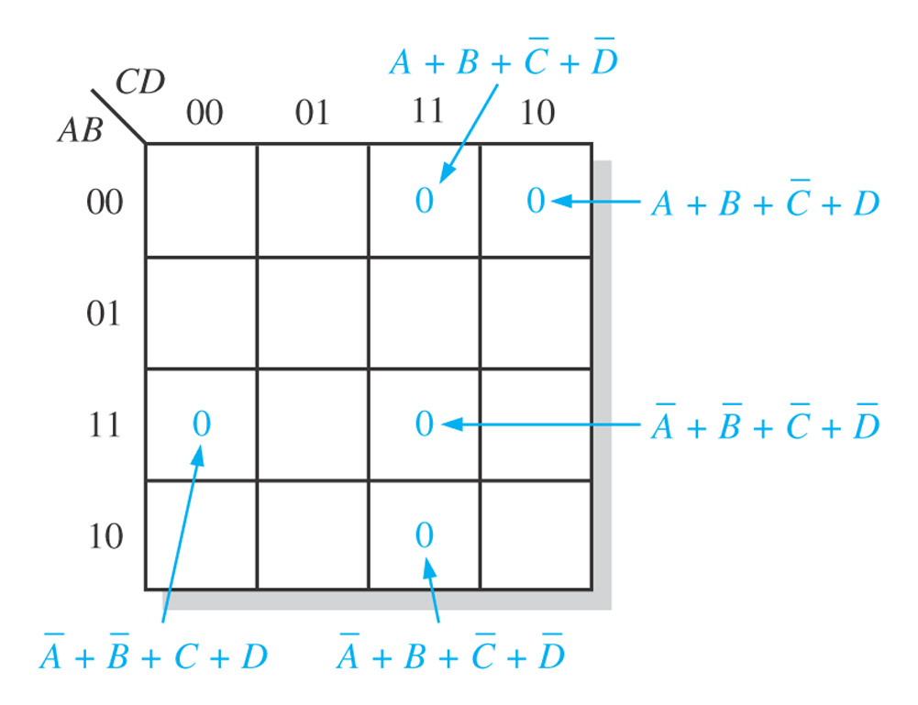
Figure 4–38
Notes:
48

Slide 49
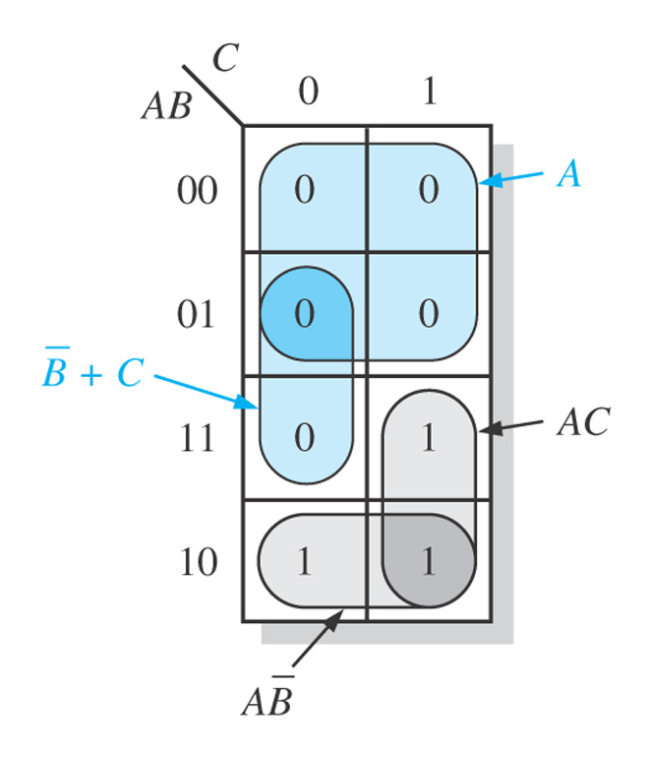
Figure 4–39
Notes:
49

Slide 50
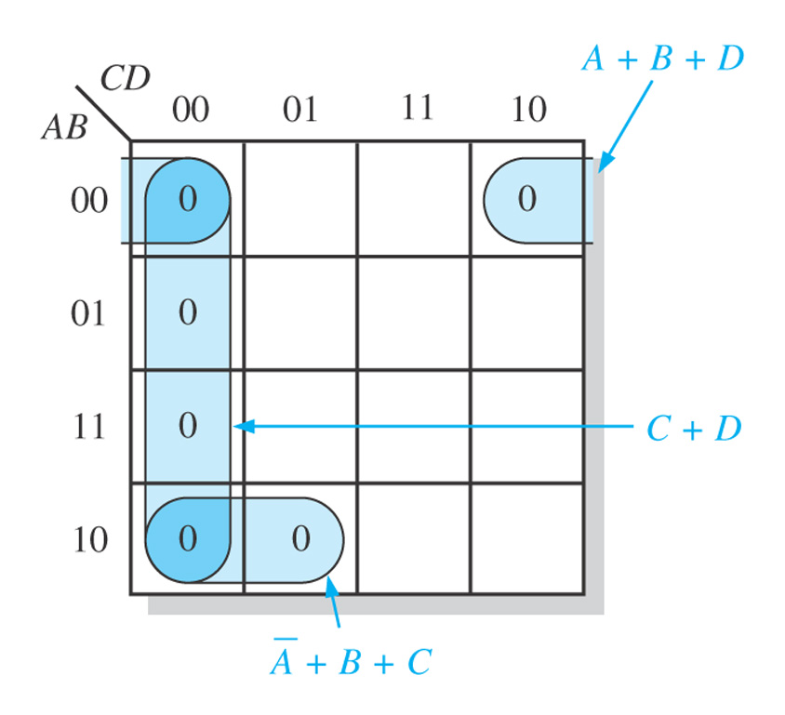
Figure 4–40
Notes:
50

Slide 51
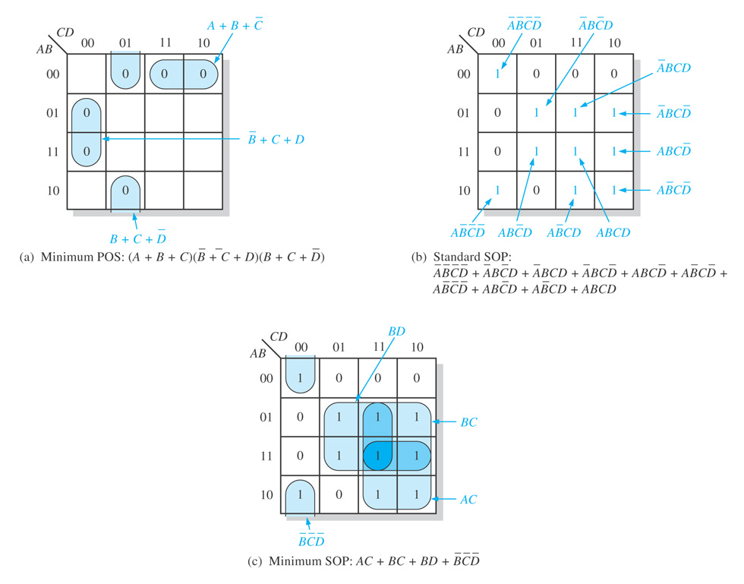
Figure 4–41
Notes:
51

Slide 52
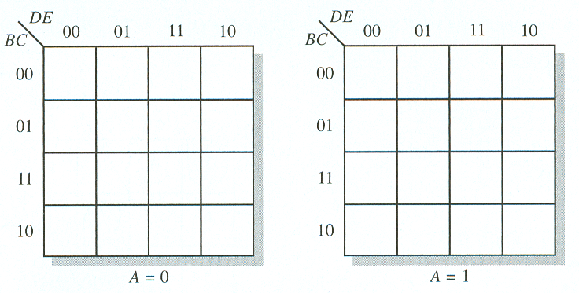
The Karnaugh Map
5-Variable Karnaugh Mapping

Slide 53
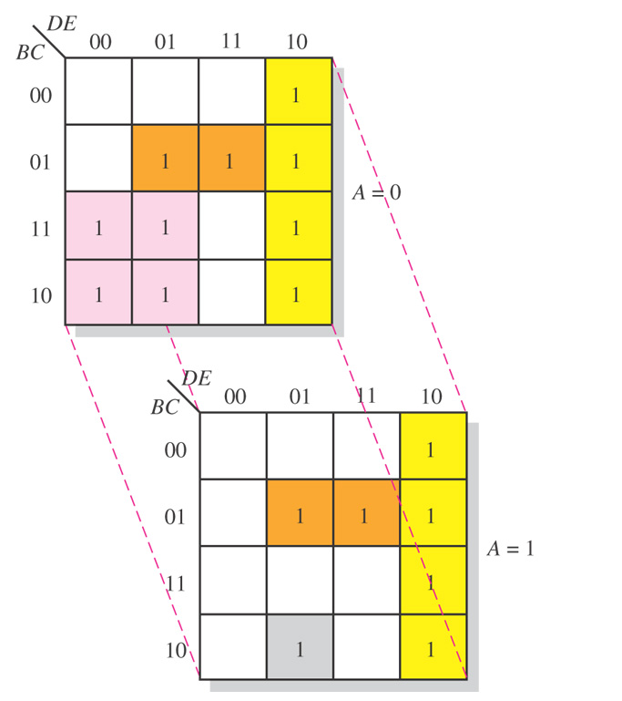
Figure 4–43 Illustration of groupings of 1s in adjacent cells of a 5-variable map.
Notes:
53

Slide 54
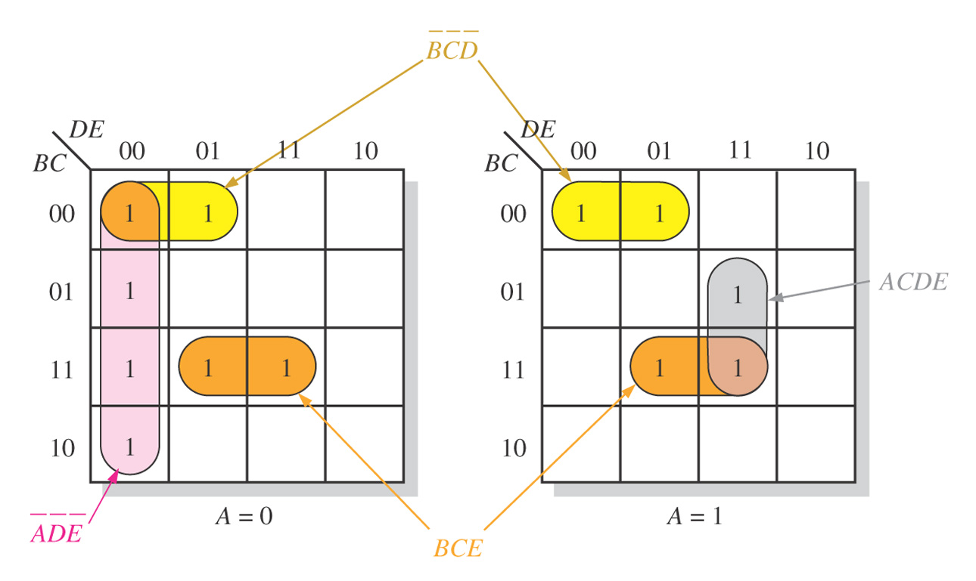
Figure 4–44
Notes:
54

Slide 55
VHDL

Slide 56
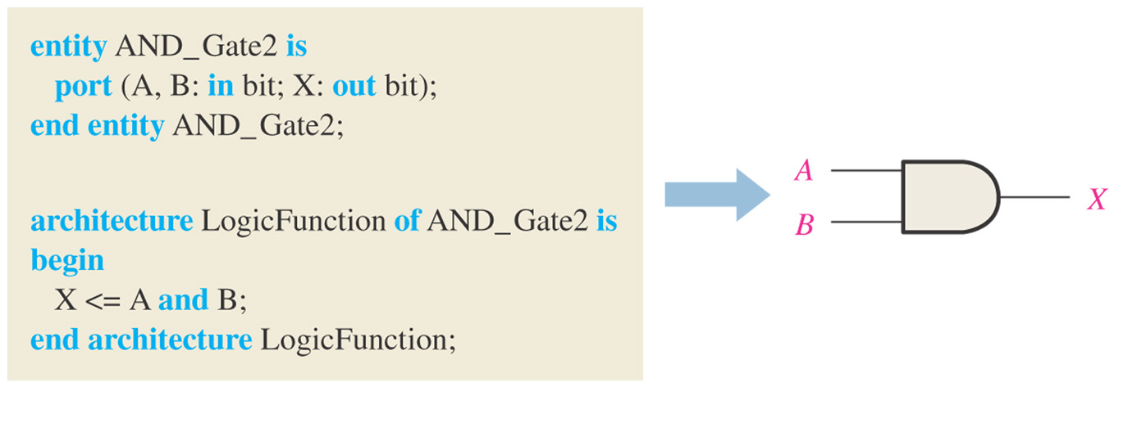
Figure 4–45 A VHDL program for a 2-input AND gate.
Notes:
56

Slide 57
VHDL
VHDL Operators
and
or
not
nand
nor
xor
xnor
VHDL Elements
entity
architecture

Slide 58
VHDL
Entity Structure
Example:
entity AND_Gate1 is
port(A,B:in bit:X:out bit);
end entity AND_Gate1

Slide 59
VHDL
Architecture
Example:
architecture LogicFunction of AND_Gate1 is
begin
X<=A and B;
end architecture LogicFunction

Slide 60
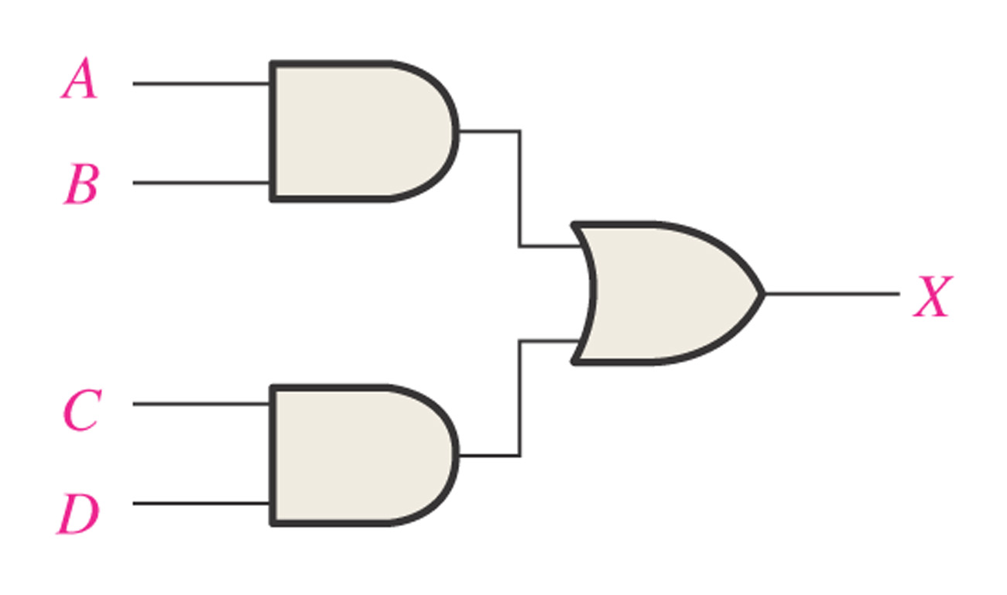
Figure 4–46
Notes:
60

Slide 61
Hardware Description Languages (HDL)
Boolean Expressions in VHDL
AND X <= A and B;
OR X <= A or B;
NOT X <= A not B;
NAND X <= A nand B;
NOR X <= A nor B;
XOR X <= A xor B;
XNOR X <= A xnor B;

Slide 62
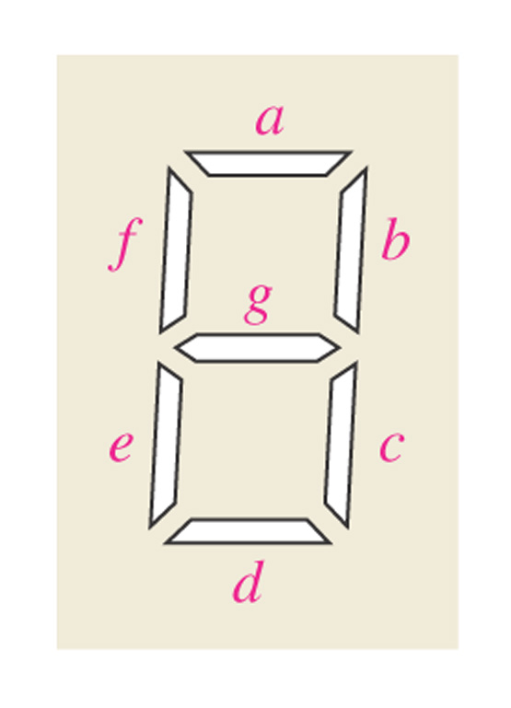
Figure 4–47 Seven-segment display format showing arrangement of segments.
Notes:
62

Slide 63
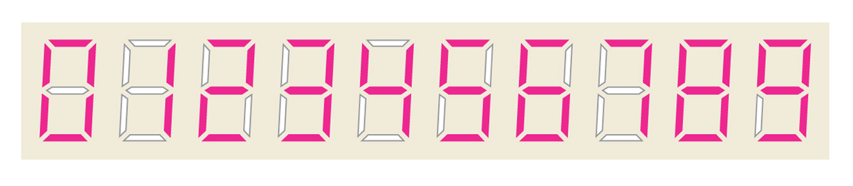
Figure 4–48 Display of decimal digits with a 7-segment device.
Notes:
63

Slide 64
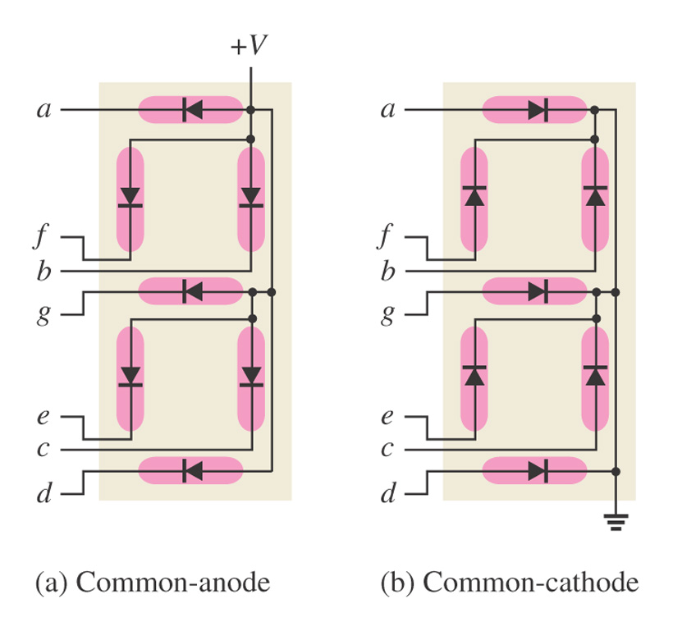
Figure 4–49 Arrangements of 7-segment LED displays.
Notes:
64

Slide 65
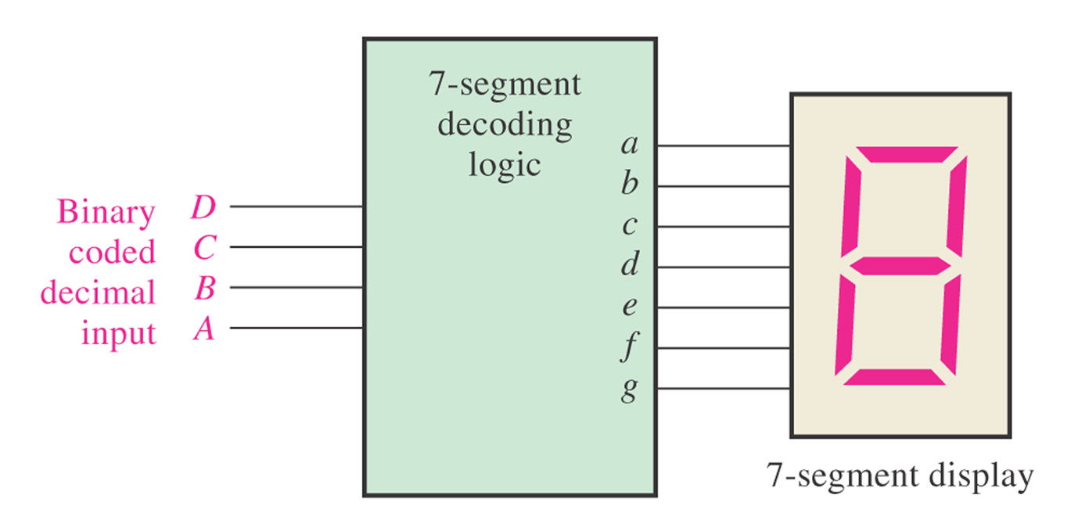
Figure 4–50 Block diagram of 7-segment logic and display.
Notes:
65

Slide 66
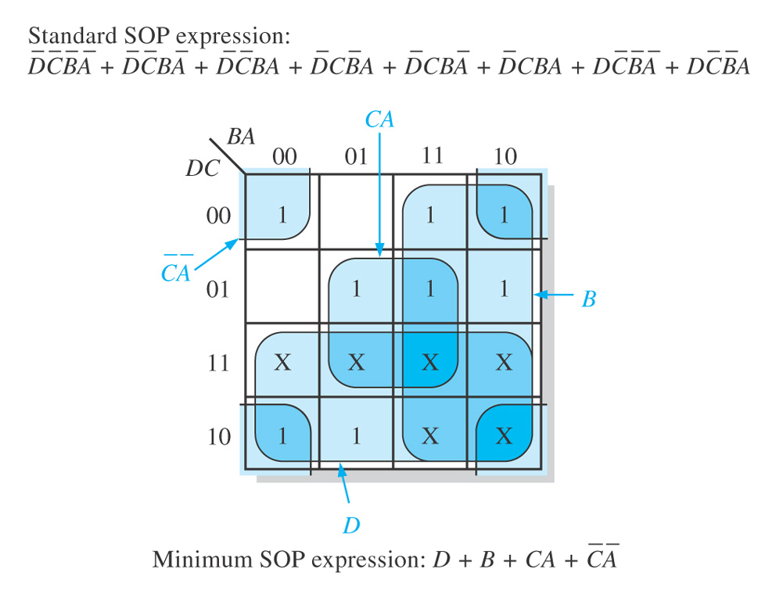
Figure 4–51 Karnaugh map minimization of the segment-a logic expression.
Notes:
66

Slide 67

Figure 4–52 The minimum logic implementation for segment a of the 7-segment display.
Notes:
67

Slide 68

Summary

Slide 69

Figure 4–54
Notes:
69

Slide 70

Figure 4–55. What is the Boolean expression for each of the logic gates?
Notes:
70

Slide 71

Figure 4–56. What is the Boolean expression for each of the logic gates?
Notes:
71

Slide 72

Figure 4–58. Derive a standard SOP and standard POS expression for each truth table.
Notes:
72

Slide 73

Figure 4–59. Reduce the function in the truth table to its minimum SOP form by using a Karnaugh map.
Notes:
73

Slide 74

Figure 4–62. Example 4-21. Related Problem answer.
Notes:
74

Slide 75

Figure 4–63. Example 4-22. Related Problem answer.
Notes:
75

Slide 76

Figure 4–64. Example 4-23. Related Problem answer.
Notes:
76

Slide 77

Figure 4–65. Example 4-24. Related Problem answer.
Notes:
77

Slide 78

Figure 4–66. Example 4-30. Related Problem answer.
Notes:
78

